Slide 1
Introduction to NLP
Introduction
Dr. John McCrae
Data Science Institute, University of Galway

Slide 2
Course Structure

Slide 3





The Team
Lecturers: John McCrae & Paul Buitelaar
Labs: Shardul Suryawanshi, Gaurav Negi & Oksana Dereza

Slide 4
Lectures
7th Sept | Introduction | John | 19th Oct | Recurrent Neural Networks | John
14th Sept | Linguistic Concepts | Paul | 26th Oct | Transformers and Deep NLP | John
21st Sept | Text Classification | John | 2nd Nov | Semantic Analysis | Paul
28th Sept | Sequence Models | John | 9th Nov | Social Media Analytics | Paul
5th Oct | Parsing | John | 16th Nov | Ethics in NLP | Paul
12th Oct | Vector Space Models | Paul | 23rd Nov | Summary | Paul/John

Slide 5
CT5121 - Advanced Topics in NLP
Machine Learning for NLP | Textual Similarity
Word Embeddings | Statistical Machine Translation
Practicalities of Deep NLP | Neural Machine Translation
Recurrent Neural Networks | Evaluation of Machine Translation
Transformers | Under-resourced Languages
Chatbots

Slide 6
Assessment
Written exam; 50% of total. Details to follow.
Two assignments: 50% of total
Assignment 1 (25%): Released on 21st September, submission deadline 14th October at 23:59 hrs
Assignment 2 (25%): Released on 9th November, submission deadline 25th November at 23:59 hrs
Past exams also available under CT5101

Slide 7
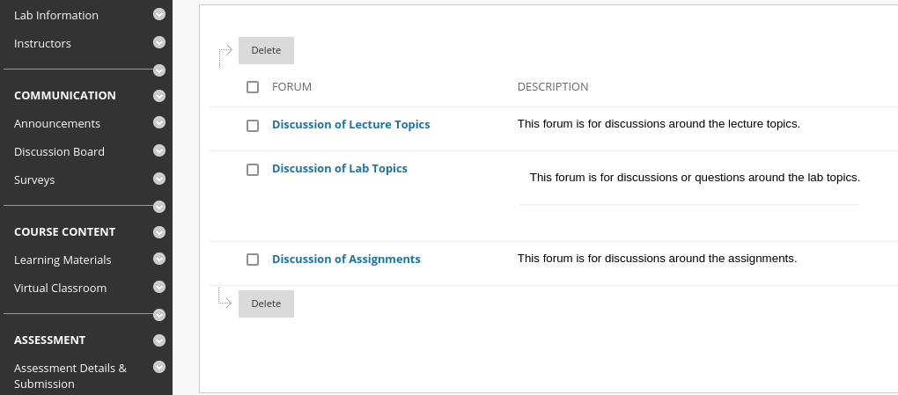
Discussion Forums

Slide 8
Recommended Reading
Lectures
Daniel Jurafsky, James H. Martin. Speech and Language Processing - An Introduction to Natural Language Processing, Computational Linguistics and Speech Recognition. Pearson Prentice Hall. 3rd edition draft https://web.stanford.edu/~jurafsky/slp3/ed3book.pdf
Labs
Steven Bird, Ewan Klein, and Edward Loper. Natural Language Processing with Python – Analyzing Text with the Natural Language Toolkit. O'Reilly. Contents at http://www.nltk.org/book/
Other
Yoav Goldberg. Neural network methods for natural language processing. Synthesis Lectures on Human Language Technologies. Morgan & Claypool -- chapters 6,7,8
Chris Manning and Hinrich Schuetze. Foundations of Statistical Natural Language Processing. MIT Press. Cambridge. Teaching materials at http://nlp.stanford.edu/fsnlp/

Slide 9
What is NLP?

Slide 10
Natural Language Processing
text text text ….
Decisions
NLP
more text
DATA
Knowledge

Slide 11
Classification
Is this text positive/negative about a product?
Does this text contain hate speech?
Is this text relevant to my business?
NLP
text text text ….
Yes/No
We can also classify two sentences as similar

Slide 12
Annotation
NLP
this text ….
this/DET text/NOUN
Part of speech
Keywords
Grammatical Errors

Slide 13
Parsing
S
NLP
VP
this text is the input
NP
V
NP
this text is the input

Slide 14
Translation
NLP
this text
このテキスト
Other text-to-text applications:
Summarization
Question Answering

Slide 15
Natural Language Generation
NLP
text text text …
DATA

Slide 16

Knowledge Extraction
Entities
NLP
Relationships
Events
Large Text Corpora

Slide 17


Speech Processing and Multimodal NLP
NLP
Out of scope of this course but many overlapping methods

Slide 18
Buzz groups
Think of one other NLP task.
Can it be solved with one of the paradigms above?

Slide 19
Why NLP?

Slide 20
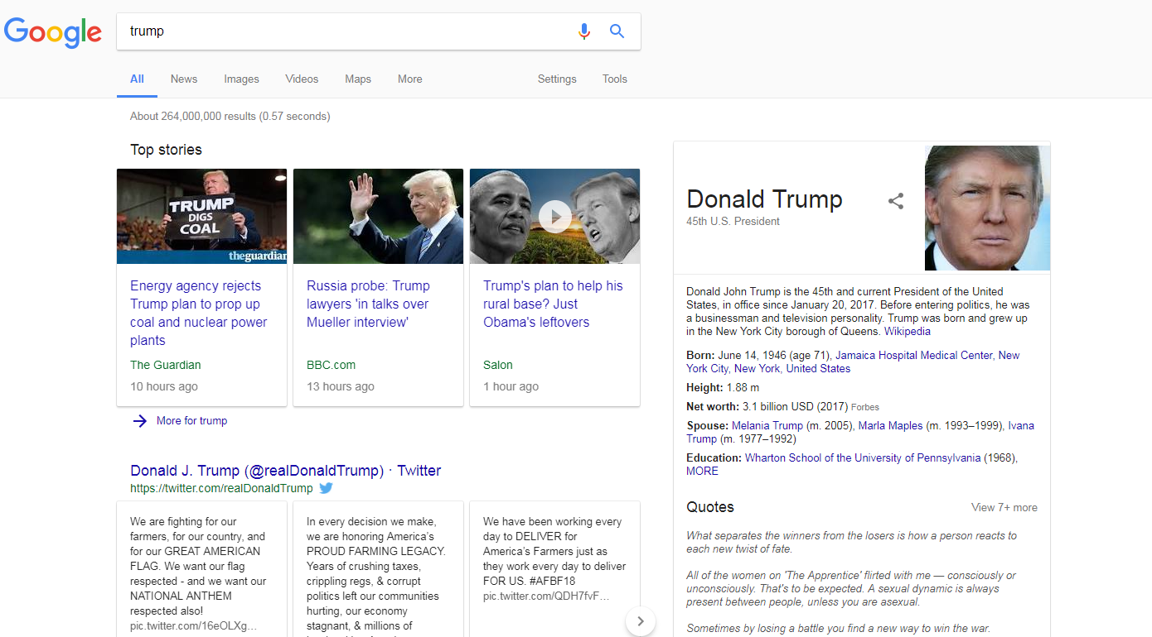
Search Engines

Slide 21
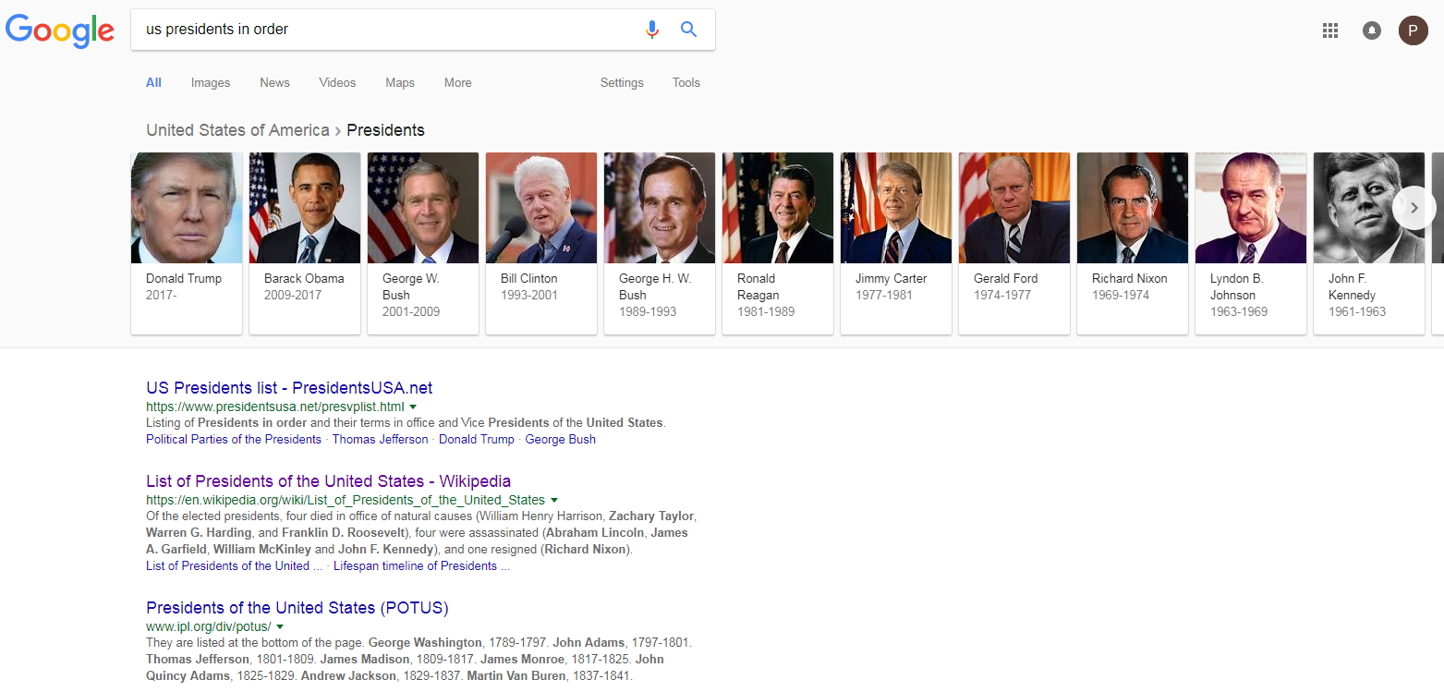
Search Engines

Slide 22
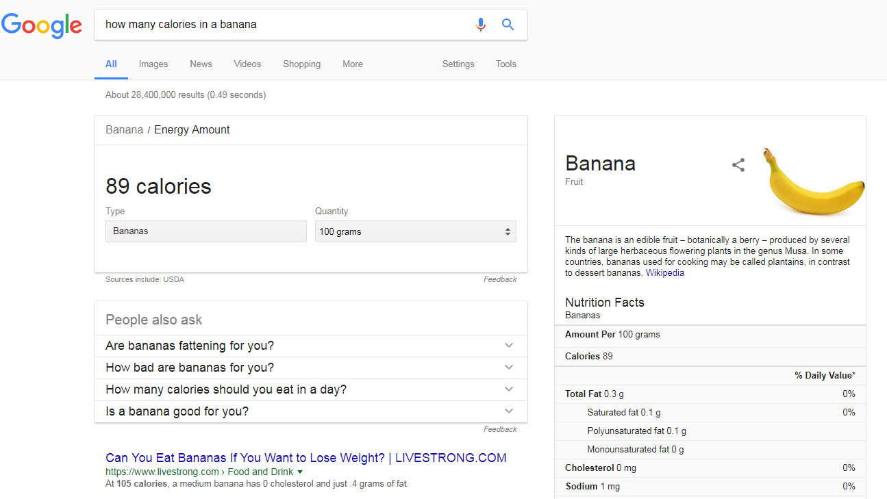
Search Engines

Slide 23
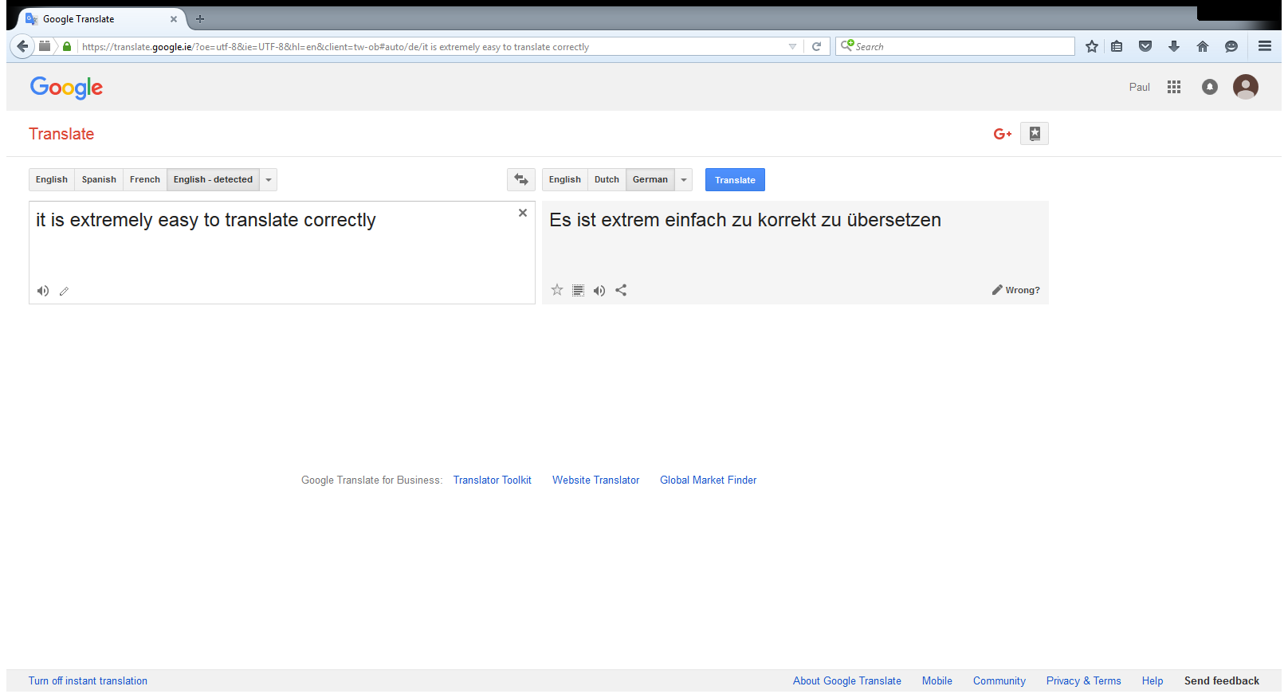
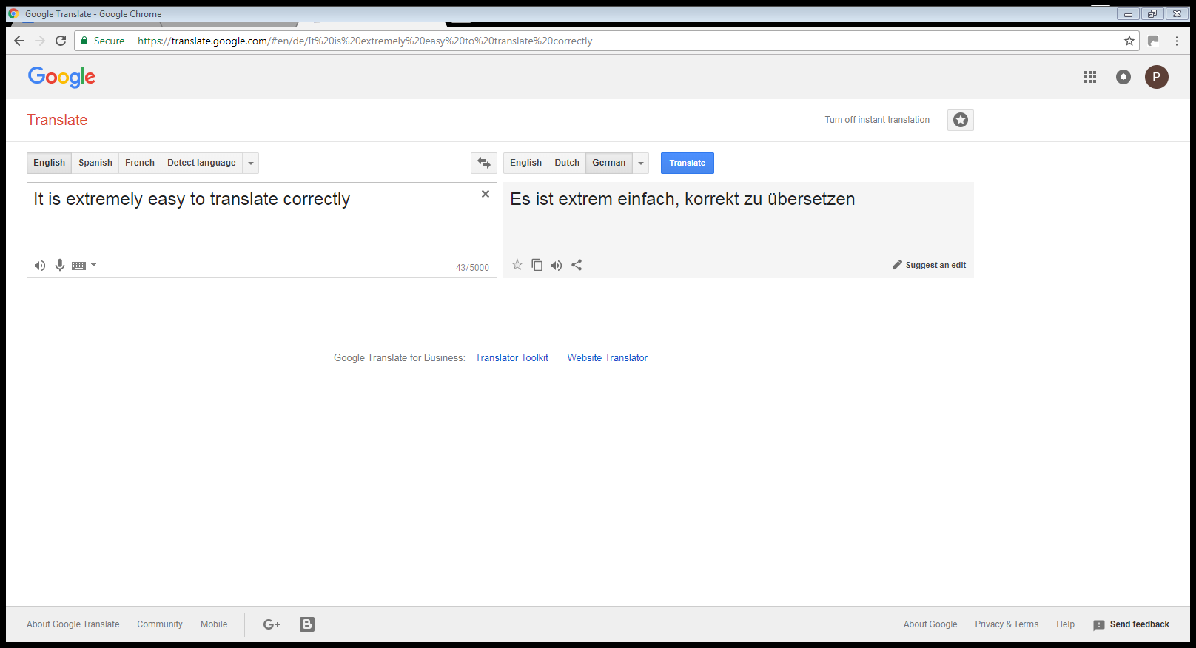
Machine Translation
X
2017
2018

Slide 24


Chatbots

Slide 25
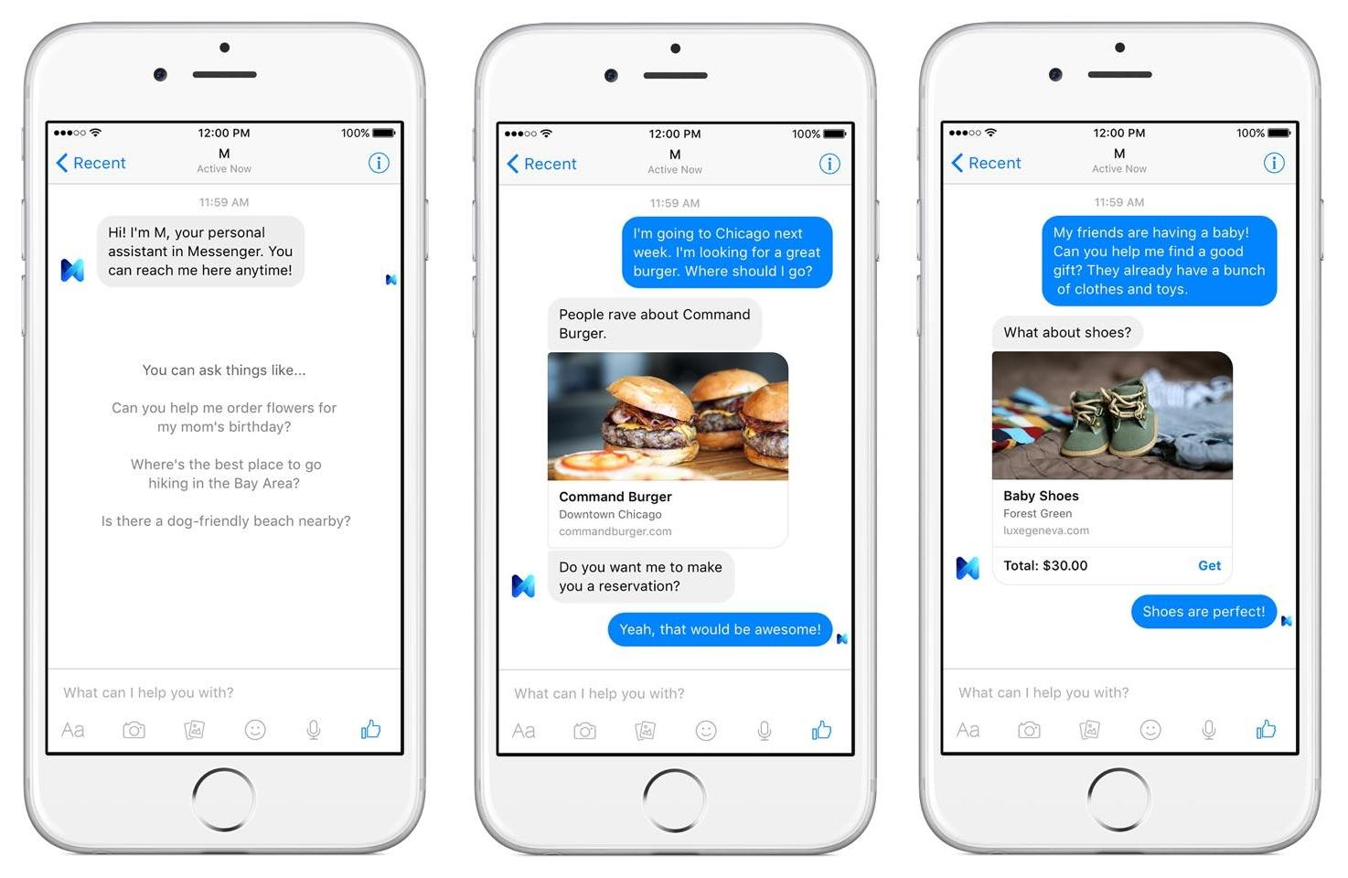
Chatbots - Dialog Systems

Slide 26
Chatbots - Dialog Systems

Slide 27
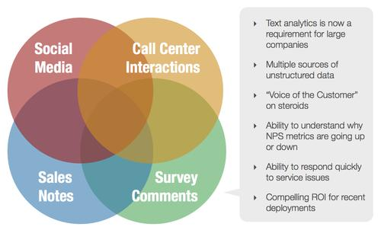
Opinion Mining

Slide 28

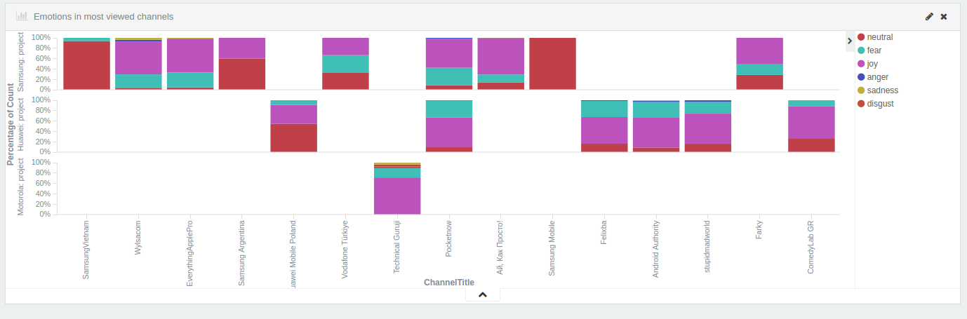
Opinion Mining
http://mixedemotions.insight-centre.org/

Slide 29
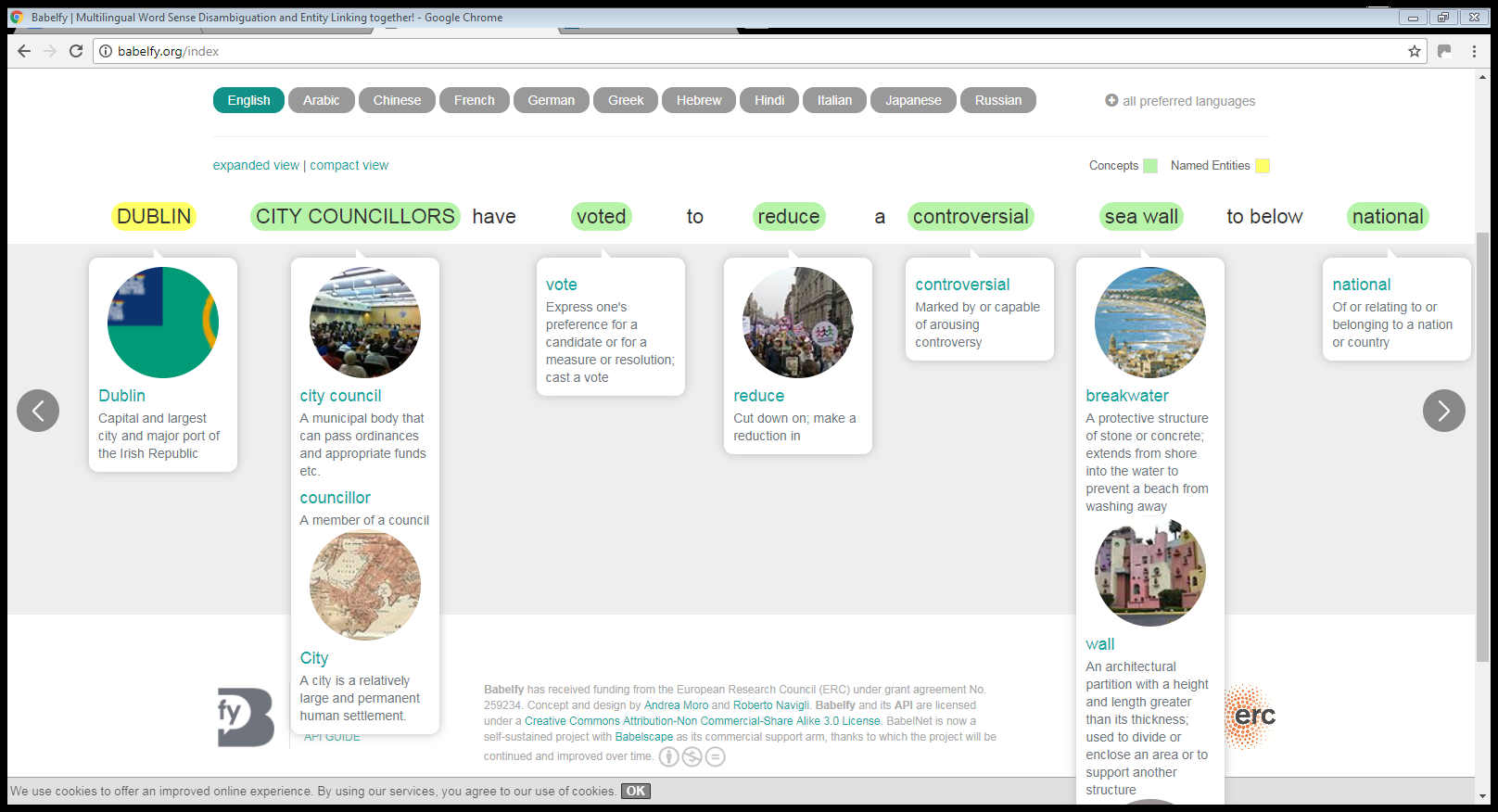
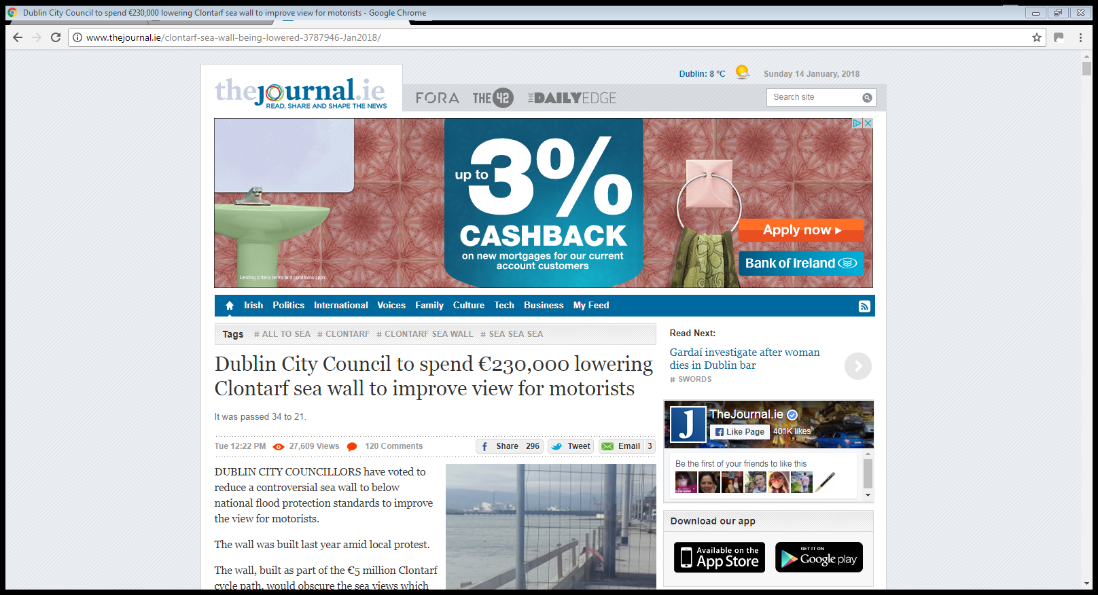

Knowledge Graphs
http://babelfy.org/

Slide 30
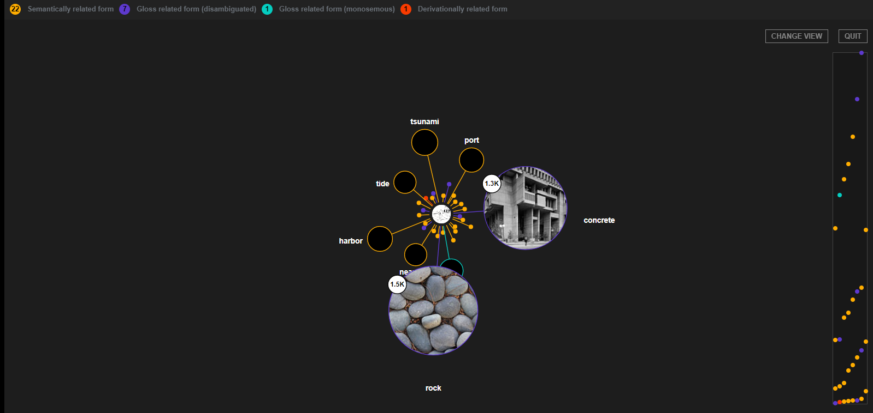
Knowledge Graphs
http://babelfy.org/

Slide 31
Discussion
What are you interested to learn in NLP?
Any topics we aren’t covering?

Slide 32
Human Language

Slide 33
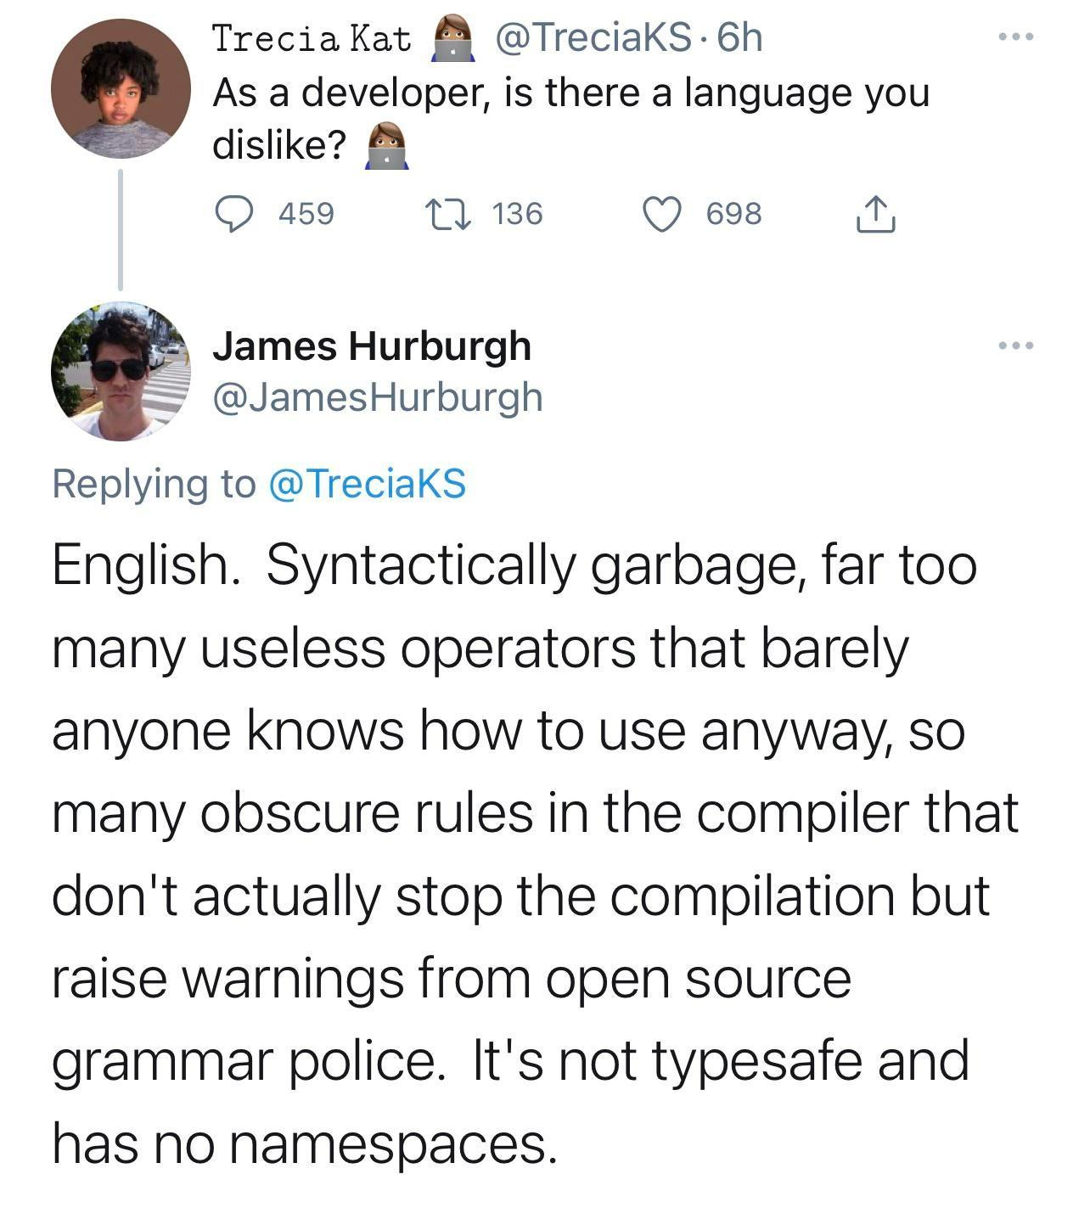

Slide 34
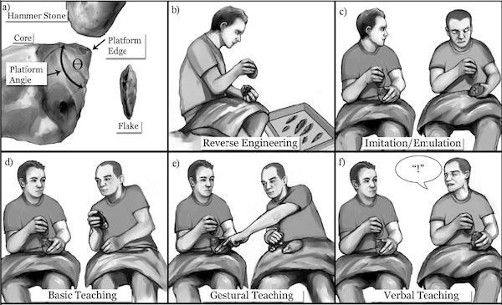
Human Language as a Social Tool

Slide 35
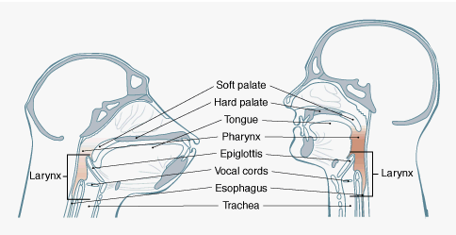
Human Language as a Biological System

Slide 36
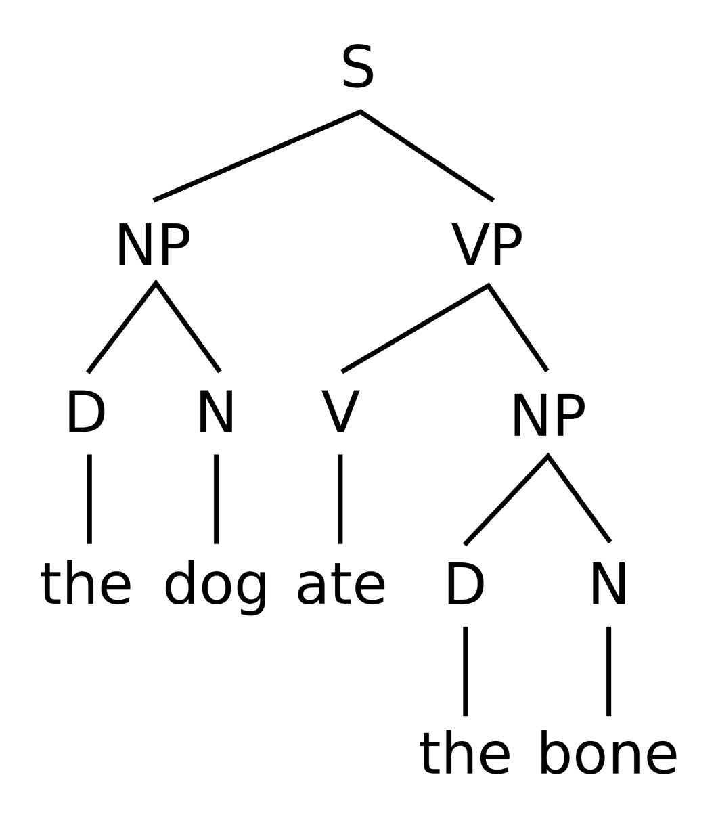
Human Language as a Logical System

Slide 37
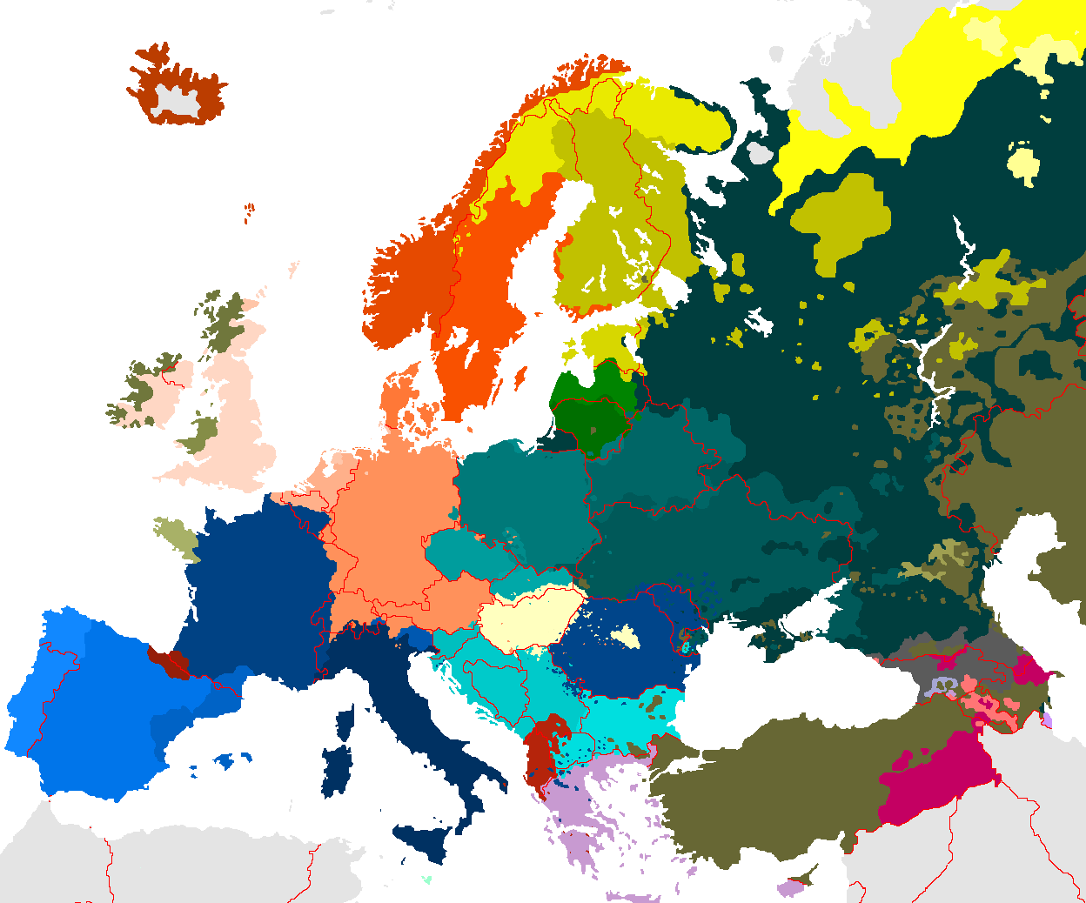
Human Language and Politics

Slide 38
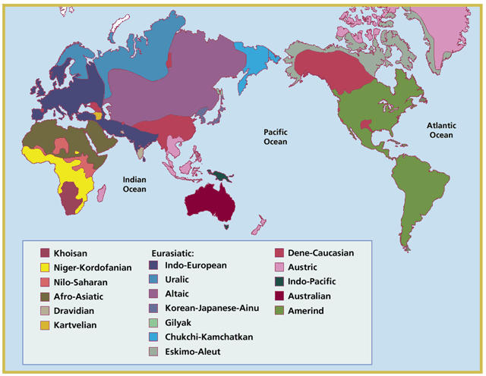
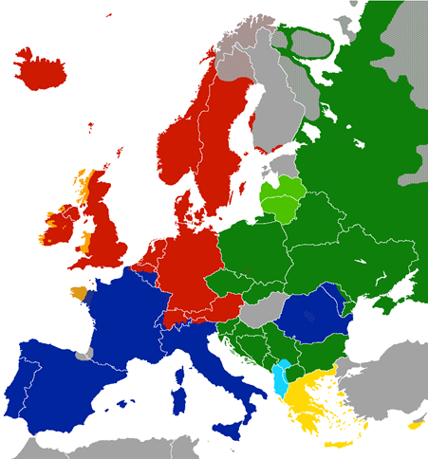
Language Families
NLP applications may be easier to transfer within language families

Slide 39
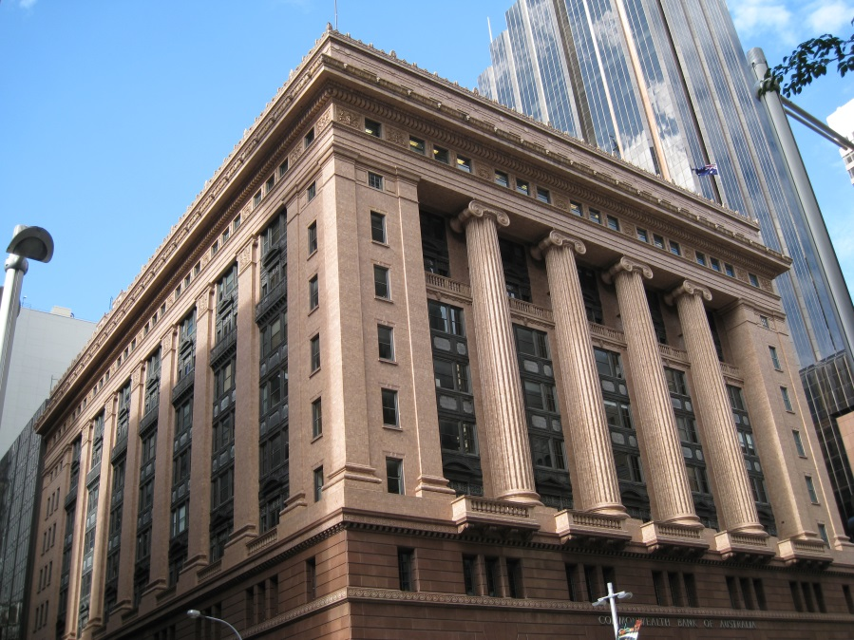
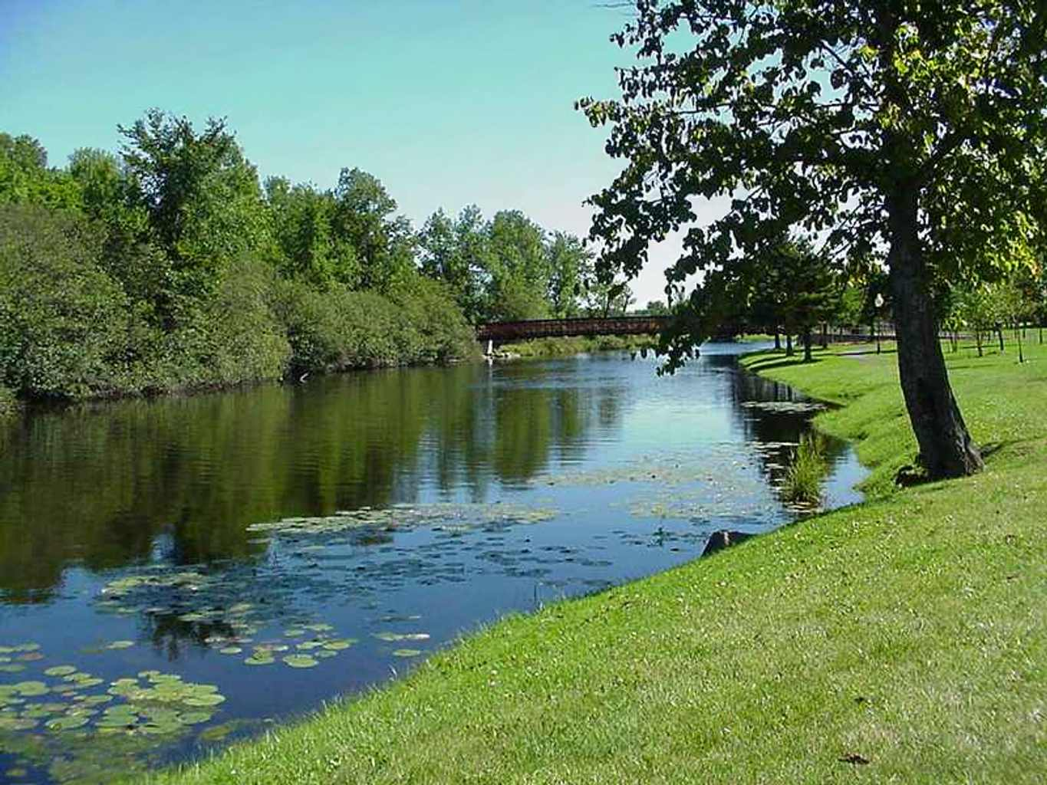
Lexical Ambiguity
savings bank vs. river bank

Slide 40
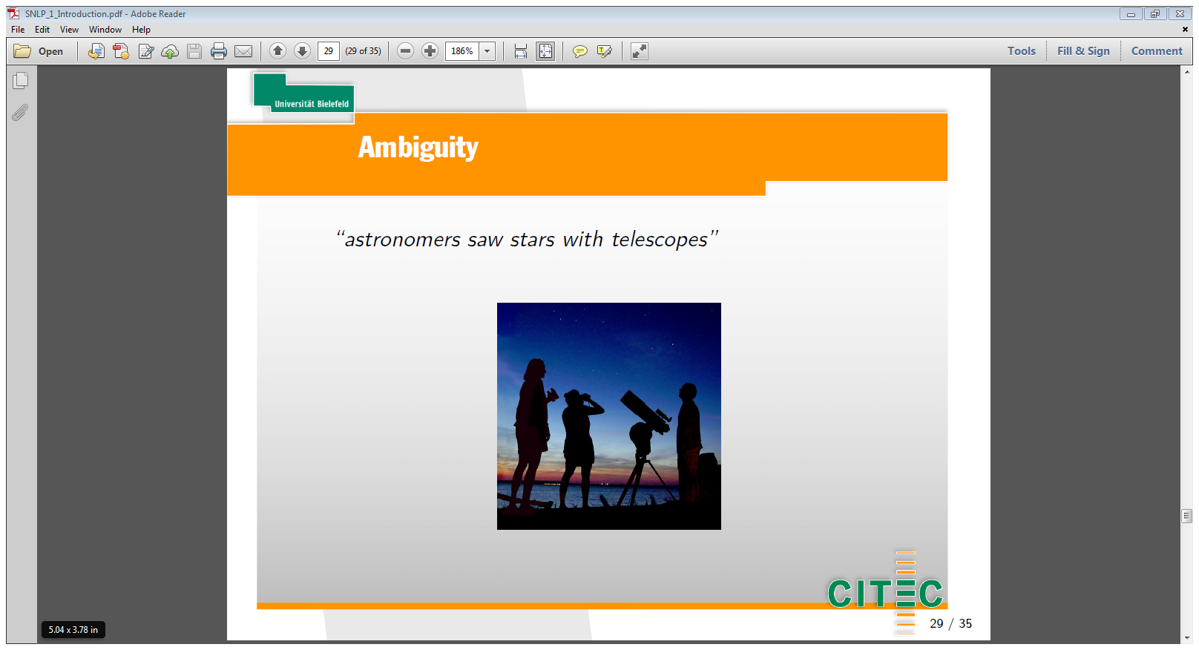
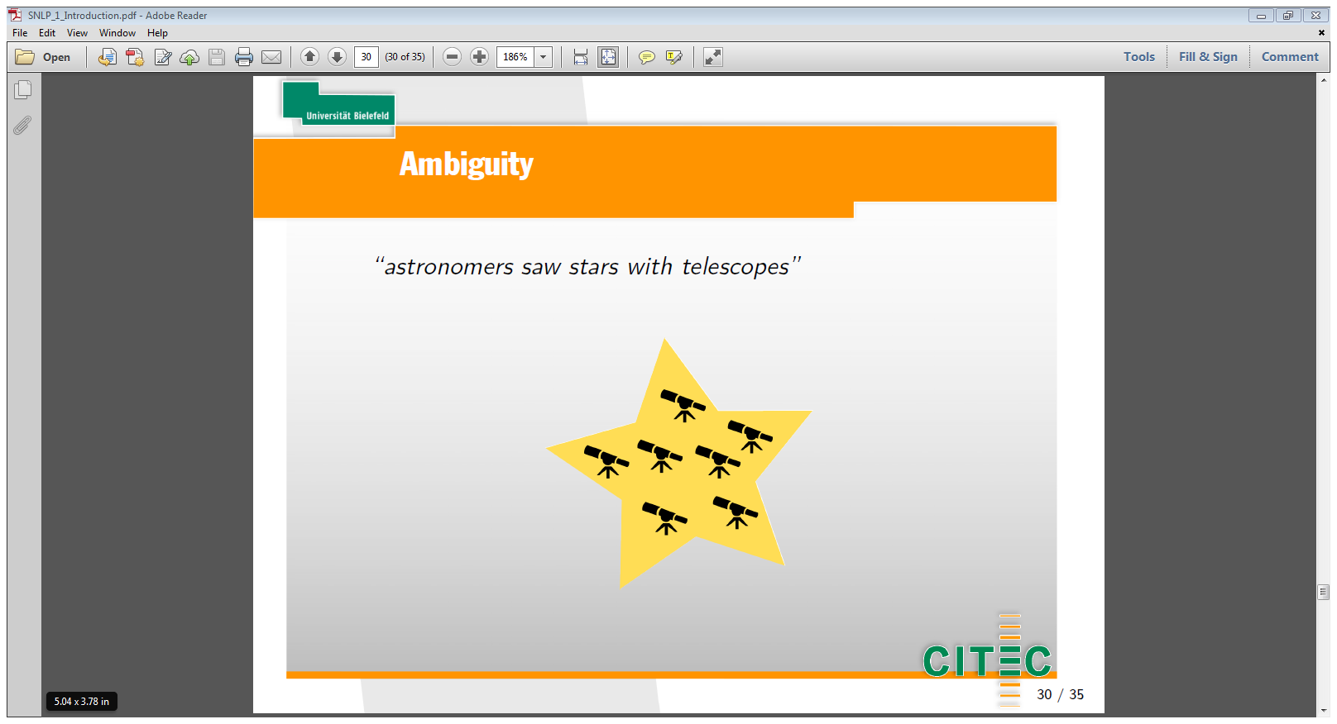
Syntactic Ambiguity
astronomers saw stars with telescopes

Slide 41
Ambiguity
John hit the man with a bat
actor
victim
instrument
John hit the man with a hat
actor
victim
Why??
John hit Simon with a hat
actor
victim
instrument

Slide 42
Mentimeter on Ambiguity

Slide 43
Resources

Slide 44

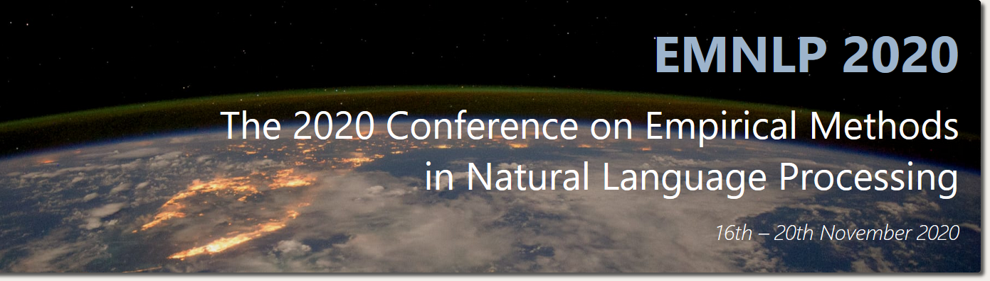


NLP Publications - Conferences

Slide 45
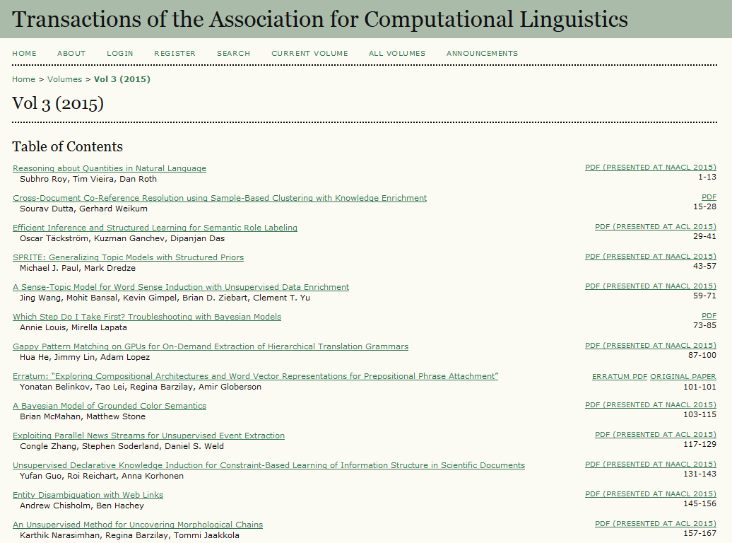
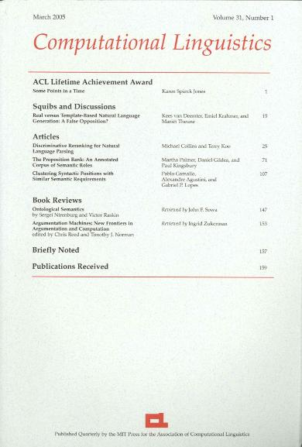

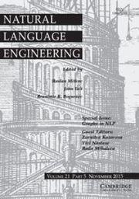
NLP Publications - Journals

Slide 46
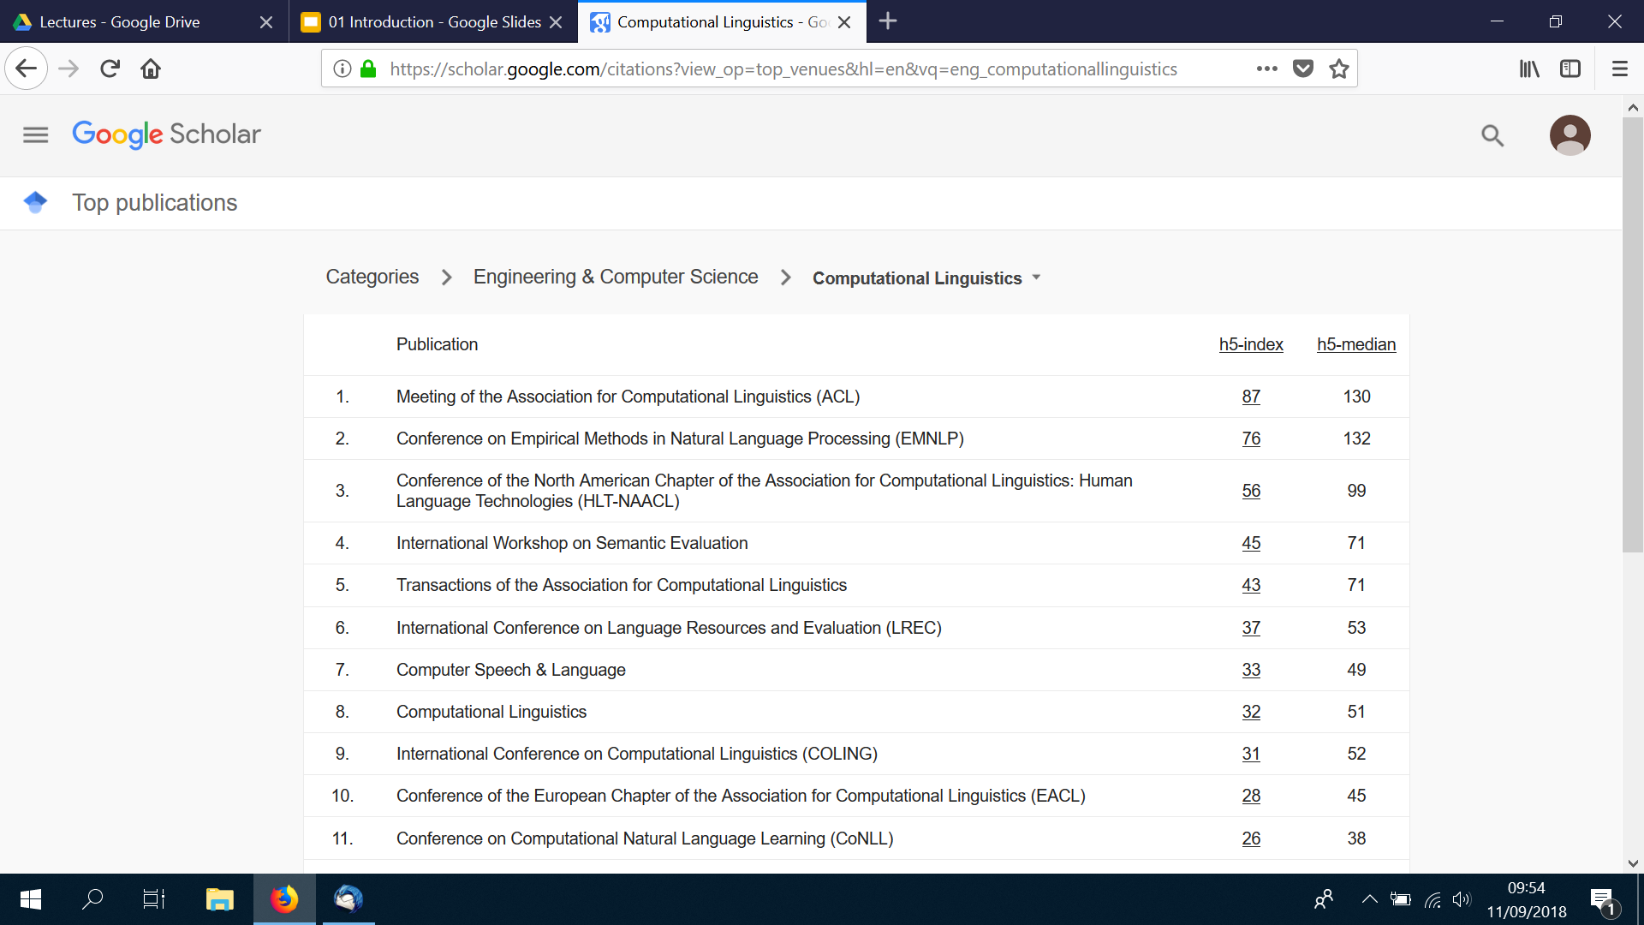
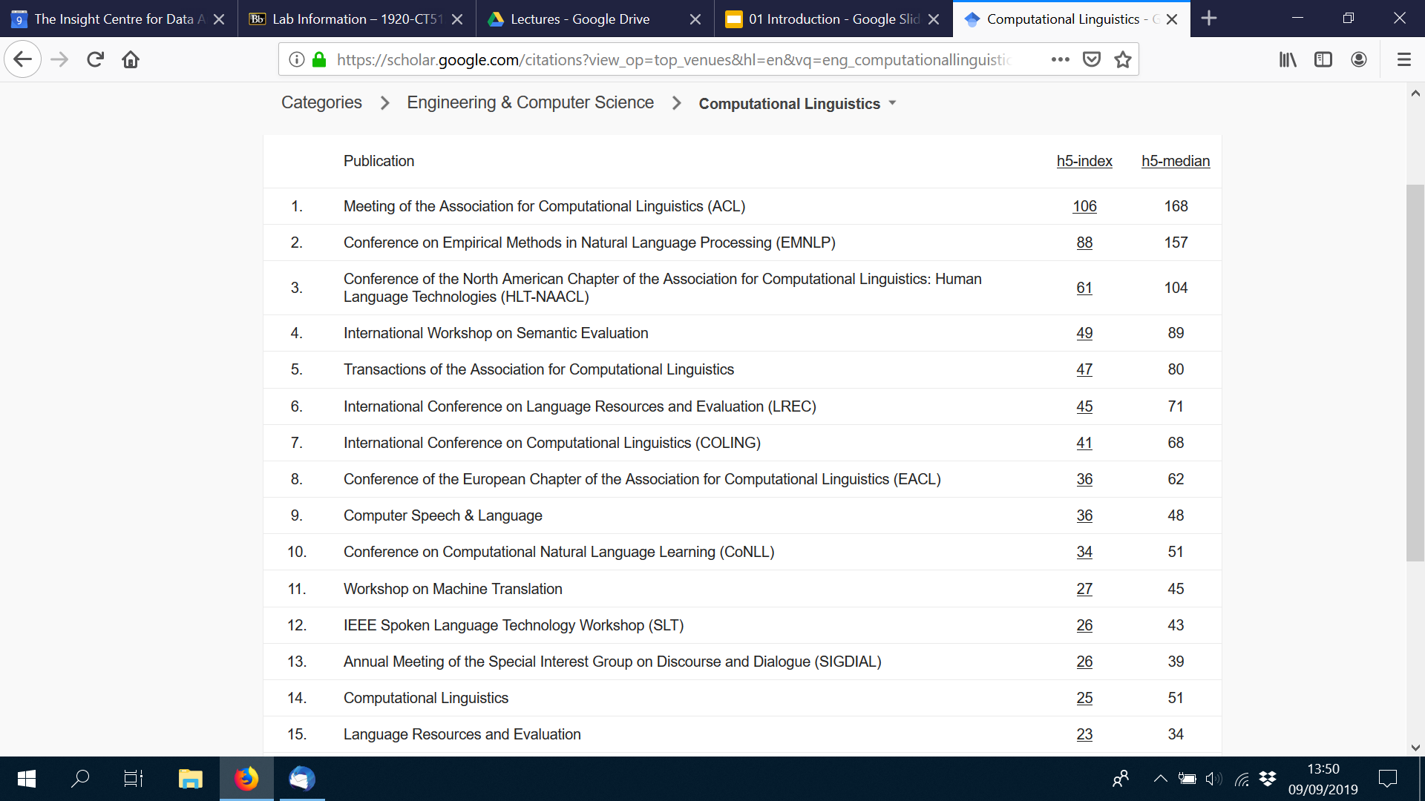
NLP Publications - Ranking

Slide 47
NLP Forums - Mailing Lists
Corpora List
http://clu.uni.no/icame/corpora/
Linguist List
http://www.linguistlist.org/

Slide 48
ACL - Professional Association for NLP
Association for Computational Linguistics (ACL)
http://www.aclweb.org/
ACL Anthology: archive of NLP conference publications
https://www.aclweb.org/anthology/

Slide 49
Lab of this Week
Intro to NLTK - labs will use NLTK in Python
https://www.nltk.org/

Slide 50
QA

